Slide 1
Course Name: Operating System
Course Code: 13005100
Introduction of operating System Unit-1(Part-II)
Presented By: Ms. Sonam Pareek
Assistant Professor

Slide 2
Course Objective
To Understand the services provided by an operating system.
1. To acquire the fundamental knowledge of the operating system architecture and its components
2. To know the various operations performed by the operating system.
3. The Operating System will identify at which Time the CPU will perform which Operation and in which Time the Memory is used by which Programs.
4. Operating System Also Known as the Resource Manager Means Operating System will Manages all the Resources those are Attached to the System means all the Resource like Memory and Processor and all the Input output Devices those are Attached to the System

Slide 3
Process
Process – a program in execution
Program is a passive entity , whereas process is an active entity.
Two processes may be associated with same program
E.g. : same user may invoke many copies of the web browser program.
Program becomes process when executable file is loaded into memory
Notes:
EX. – though text sections are equivalent, data, heap, stack sections vary.
Galvin -102
Program : passive entity – file containing list of instructions stored on disk
Program becomes process when executable file is loaded into memory

Slide 4
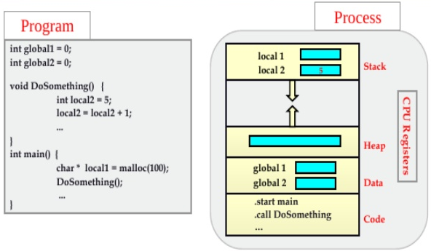
Program vs. Process

Slide 5
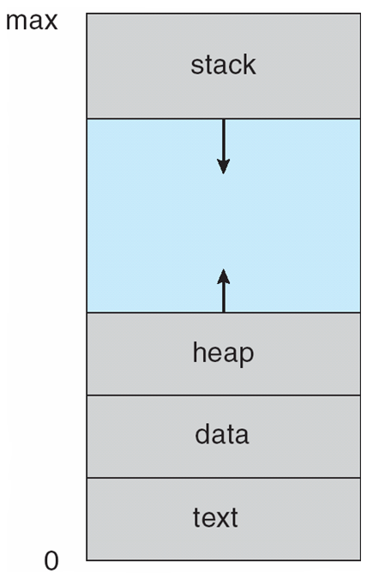
Process
A process includes:
program counter
Stack
contain temporary data such as local variables, function parameters, return addresses
data section
contain global variables
Heap
contain memory dynamically allocated during process run time
Notes:
Above diagram indicates the structure of a process in memory
Process- contains program counter which indicates next instruction to execute.

Slide 6
Process States
As a process executes, it changes state.
new: process is being created
ready: process is waiting to be assigned to a processor
running: Instructions are being executed
waiting: process is waiting for some event to occur
terminated: process has finished execution
Notes:
Every process has a lifecycle/lifetime , & during its lifetime it undergoes through various stages. As process executes, the state of a process gets changed.
Compare it with CAR state in CAR racing. When you start the CAR it is in New state.
When u change the gear it enters into ready state. When u accelerate & CAR starts moving it enters into running state. If u encounter red Singnal…. Then CAR enters waiting state…. When u reach ur destination u turn off the engine so enters terminated state

Slide 7
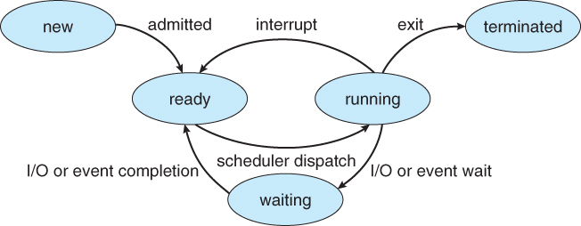
Diagram of Process State (5 State Model)
Notes:
Also called 5 state process diagram
Explain meaning of direction of arrows

Slide 8
Process Transition
Null → New: new process is created to execute the program
New → Ready: new process ready for execution
Ready → Running: a ready process starting execution
Running → Exit: a running process is terminated (completed or aborted)
Running → Ready: may happen if a process’s time slice is over
Running → Blocked: process requires some I/O operation or some other event, for which it must go into blocked state
Blocked/ Waiting → Ready: when event, for which process is waiting, is over
Ready → Exit: happens in a parent-child relationship. If a parent is terminated then all child processes associated with it are also terminated.
Blocked / Waiting → Exit: same as above

Slide 9
Process Scheduling
Objective : To maximize the CPU utilization scheduling is done among various processes.
Process scheduler selects among available processes for next execution on CPU
Maintains scheduling queues of processes
Job queue – set of all processes in the system
Ready queue – set of all processes residing in main memory, ready and waiting to execute
Device queues – set of processes waiting for an I/O device
Processes migrate among the various queues
Notes:
The objective of multiprogramming is to have some process running at all times so that CPU can be utilized fully.

Slide 10
Schedulers
Part of OS responsible for changing state of the process.
Their main task is to select the jobs to be submitted into the system and to decide which process to run.
It aims at :
Making sure that each process gets a fair share of the CPU
Keep the CPU busy 100% of the time.
Minimize response delays.
Notes:
Ekta-61 + http://www.tutorialspoint.com/operating_system/os_process_scheduling.htm
Process scheduler is responsible for taking process out of ready queue & assign it to CPU for its execution

Slide 11
Scheduler Types
Long Term / Job scheduler
Short Term / CPU Scheduler
Medium Term
selects processes from secondary storage device and load them into memory for execution.
Controls degree of multiprogramming
selects which process should be executed next and allocates CPU
Removes processes from memory and reintroduces it at a later time - swapping
Helps in reducing degree of multiprogramming
Notes:
Long term scheduler → controls the degree of multiprogramming(no. of processes in memory)
If degree of multiprogramming stable, then average rate of process creation = average departure rate of process leaving the system.
Time sharing system may have medium term scheduler

Slide 12
Schedulers
Short-term scheduler is invoked very frequently (100 milliseconds) ⇒ (must be fast)
Long-term scheduler is invoked less frequently (seconds, minutes) ⇒ (may be slow)
Notes:
short CPU bursts = = process requires CPU for less time.
Short term scheduler is invoked once every 100 milliseconds
Long T. S. may need to be invoked only when process leaves the system

Slide 13
CPU-I/O bursts
Process execution consists of a cycle of CPU execution and I/O wait
CPU-bound process: performs lots of computations in long bursts, very little I/O
I/O-bound process: performs lots of I/O followed by short bursts of computation
Mix of CPU-bound and I/O-bound processes required to maximize CPU and I/O device usage
Notes:
Processes can be described as either:
I/O-bound process – spends more time doing I/O than computations, many short CPU bursts
CPU-bound process – spends more time doing computations; few very long CPU burst

Slide 14
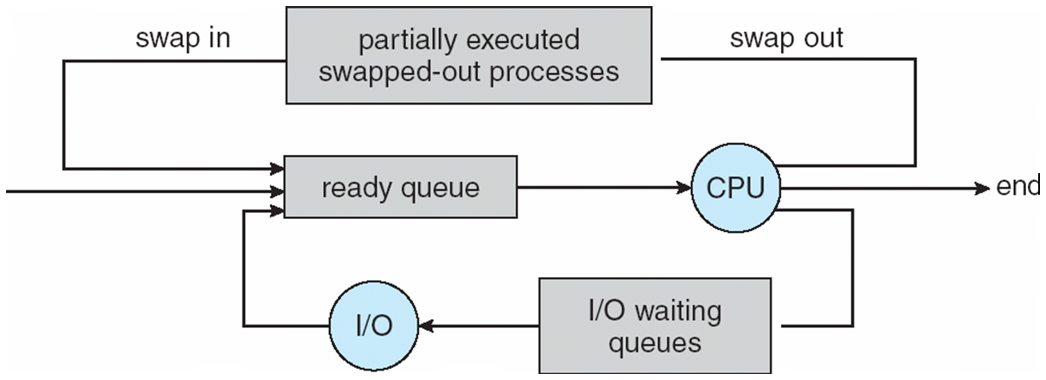
Medium Term Scheduling
Notes:
The medium term scheduler is in-charge of handling the swapped out-processes.
Running process may become suspended if it makes an I/O request. Suspended processes cannot make any progress towards completion. In this condition, to remove the process from memory and make space for other process, the suspended process is moved to the secondary storage. This process is called swapping, and the process is said to be swapped out or rolled out. Swapping may be necessary to improve the process mix.
Medium term scheduling is essentially concerned with memory management, hence it's very often designed as a part of the memory management subsystem of an OS. Its efficient interaction with the short term scheduler is essential for system performances, especially in virtual memory systems. This is the reason why in paged system the pager process is usually run at a very high (dispatching) priority level.
Long term scheduling obviously controls the degree of multiprogramming in multitasking systems, following certain policies to decide whether the system can honour a new job submission or, if more than one job is submitted, which of them should be selected. The need for some form of compromise between degree of multiprogramming and throughput seems evident, especially when one considers interactive systems. The higher the number of processes, in fact, the smaller the time each of them may control CPU for, if a fair share of responsiveness is to be given to all processes. Moreover we have already seen that a too high number of processes causes waste of CPU time for system housekeeping chores (trashing in virtual memory systems is a particularly nasty example of this). However, the number of active processes should be high enough to keep the CPU busy servicing the payload (i.e. the user processes) as much as possible, by ensuring that - on average - there always be a sufficient number of processes not waiting for I/O.

Slide 15
Schedulers
Long-Term Scheduler
J5
J4
J3
J2
J1
OS
Job1 (J1)
Jobs on the Secondary Storage
J2
Medium-Term Scheduler (Swap-out)
J3
J3
J5
Swap Space
Medium-Term Scheduler (Swap-in )
J4
Memory
CPU
Short-Term Scheduler

Slide 16
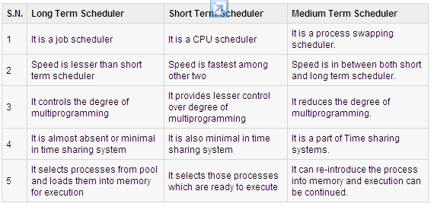
Comparison between Schedulers

Slide 17
Types of Scheduling
Nonpreemptive / Cooperative Scheduling
Once the CPU has been allocated to a process, the process keeps the CPU until its termination or its transition to the waiting state.
Long/ low priority jobs may make short/ high priority jobs wait
Simple to implement
Preemptive Scheduling
Even if the CPU has been allocated to a certain process, CPU can be snatched from this process any time due to priority reasons.
Useful where high priority tasks require immediate attention. Ex. Real time or interactive systems
Notes:
Madhu Slides + Galvin 186
Problem with preemption – process modifying data- preempted in between – data inconsistent
Solution – wait for a system call to complete or for an i/o block to take place before a context switch.

Slide 18
Preemptive vs. nonpreemptive scheduling
CPU scheduling decisions may take place when a process switches from :
Running → waiting state. Ex. I/O request. Non - preemptive
Running → ready state. Ex. interrupt or timeout occurs. Preemptive
Waiting → ready. Ex. completion of I/O Preemptive
Terminates Non preemptive
Notes:
scheduling under 1 and 4 is nonpreemptive
once a process starts, it runs until it terminates or willingly gives up control
simple and efficient to implement – few context switches
examples: Windows 3.1, early Mac OS
all other scheduling is preemptive
process can be "forced" to give up the CPU (e.g., timeout, higher priority process)
more sophisticated and powerful
examples: Windows 95/98/NT/2K, Mac OS-X, UNIX

Slide 19
Scheduling Algorithm
These algorithms decide which of the processes in the ready queue is to be allocated the CPU.
Different CPU scheduling algorithms are:
First-Come, First-Served Scheduling
Shortest-Job-First Scheduling
Round-Robin Scheduling
Priority Scheduling
Multilevel Queue Scheduling
Multilevel Feedback Queue Scheduling

Slide 20
Scheduling Criteria
CPU utilization – keep the CPU as busy as possible
Throughput – no. of processes that complete their execution per time unit
Turnaround time – amount of time to execute a particular process. Interval from the time of submission to the time of completion.
Waiting time – amount of time a process spends waiting in the ready queue
Response time – amount of time it takes from when a request was submitted until the first response is produced, not final output
Notes:
Madhu slides

Slide 21
Process Scheduling Criteria
CPU Utilization – Aim to keep CPU busy for 100 % of time
Increased Throughput
Minimize Turnaround time
Minimize Waiting time
Less Response time
Balanced Utilization – All resources should be fully utilized
Fairness – avoid starvation
Priority – preferential treatment for processes with higher priority
Notes:
Galvin – 187 + Schaums – 20
Scheduling is done based on certain criteria. Whatever scheduling algorithms we use, it should satisfy some criteria's then only it will be more effective.
Throughput – 2 processes completed in 1 minute OR 10 processes completed in 1 min.
Increased throughput means more number of processes should be completed per unit time

Slide 22
Formula
Actual waiting time = Wait Time - Arrival time
Turnaround Time = Process termination time – Process Arrival time
Throughput = time to complete all the processes
no. of processes

Slide 23
First-Come, First-Served Scheduling (FCFS)
Allocates CPU in the order in which the process arrive.(Non-preemptive)
Implementation is managed with FIFO queue.
Notes:
Galvin-188
FIFO queue → when process enters ready queue its PCB is linked to tail of the queue. When CPU is free it allocated to process from the head of the queue. Running process is then removed from the queue.

Slide 24
First-Come, First-Served Scheduling (FCFS)
Advantages :
Simple to understand and code
Suitable for batch systems
Disadvantages :
Waiting time can be large if short request wait behind long one.
A proper job mix is needed to achieve good result.
Suffers from Convoy effect : All processes wait for one big process to free CPU. This results in lower CPU and device utilization.
Not suitable for time sharing systems
Notes:
Galvin-188
FIFO queue → when process enters ready queue its PCB is linked to tail of the queue. When CPU is free it allocated to process from the head of the queue. Running process is then removed from the queue.

Slide 25
First-Come, First-Served Scheduling
Consider the following set of processes that arrive at time 0 with length of CPU burst time(milliseconds).
Process Burst Time
P1 24
P2 3
P3 3
Suppose that the processes arrive in the order: P1 , P2 , P3
Notes:
→ Burst Time is actually time that is required to complete execution of particular task or process.

Slide 26
First-Come, First-Served Scheduling
Actual waiting time = Wait Time - Arrival time
Turnaround Time = Process termination time – Arrival time
Throughput = time to complete all processes / no. of processes
P1
P2
P3
Gantt Chart Schedule
0
24
27
30
Waiting time for P1 = 0 ms; P2 = 24ms; P3 = 27ms
Average waiting time: (0 + 24 + 27)/3 = 17ms
Turnaround Time : P1 = (24-0) = 24ms, P2 = (27-0) = 27ms,
P3 = (30-0) = 30 ms.
Avg. Turnaround Time = (24+27+30)/3 = 27ms
Throughput = (30/3) = 10 time units per job

Slide 27
First-Come, First-Served Scheduling
Actual waiting time = Wait Time - Arrival time
Turnaround Time = Process termination time – Arrival time
Throughput = time to complete all processes / no. of processes
Suppose processes arrive in order: P2, P3, P1
P2
P3
P1
0
3
6
30
Waiting time for P1 = 6 ms; P2 = 0 ms; P3 = 3 ms
Avg. W. T.: (6 + 0 + 3)/3 = 3 ms
Turnaround Time: P1 = 30 ms, P2 = 3 ms , P3 = 6 ms
Avg. T. T. = (30+3+6)/3 = 13ms
Much better than previous case
Previous case Convoy effect - short process behind long process
Notes:
Throughput remains same as above.
→ Convoy effect : actual execution time of the process is less than waiting time.

Slide 28
First-Come, First-Served Scheduling
Processes | Arrival time | Burst Time
A | 0 | 8
B | 0 | 4
C | 1 | 6
D | 2 | 1
Quantum = 2

Slide 29
First-Come, First-Served Scheduling
Processes | Arrival | Burst Time
A | 0 | 8
B | 0 | 4
C | 1 | 6
D | 2 | 1
A
B
C
D
0
8
12
18
19
Waiting time for A = 0 ms; B = 8 ms; C = (12-1) = 11ms; D = (18-2)= 16ms
Turnaround Time : A = (8-0) = 8ms, B = (12-0) = 12ms,
C = (18-1) = 17 ms, D = (19-2) = 17ms.
Throughput = 19/4 time units per job

Slide 30
Question
Processes | Arrival time | Burst Time
A | 0 | 8
B | 0 | 4
C | 1 | 6
D | 2 | 1
Quantum = 2

Slide 31
Round Robin Scheduling
Designed for time sharing system
Each process gets a small unit of CPU time (time quantum q), usually 10-100 milliseconds. After this time has elapsed, the process is preempted and added to the end of the ready queue.
Similar to FCFS, but preemptive
Performance depends upon
Size of time quantum
Large : same as FCFS – performance degrades
Small : no. of context switch increases

Slide 32
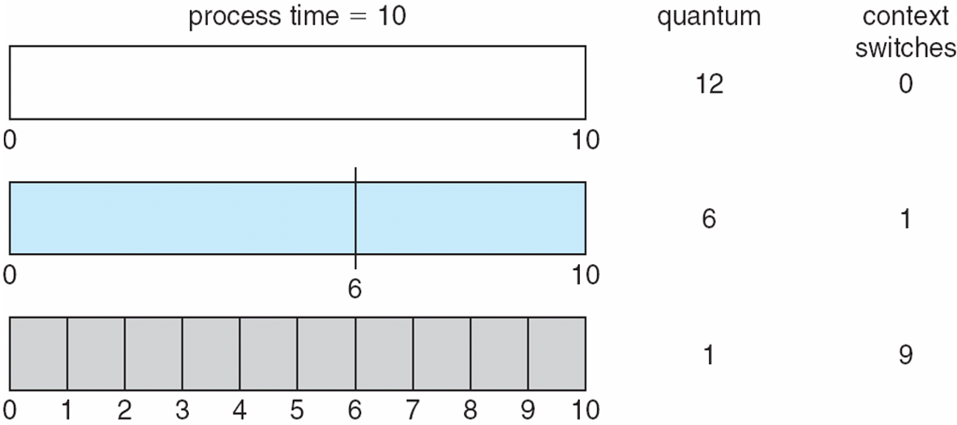
Round Robin Scheduling

Slide 33
Round Robin Scheduling
Process Burst Time
P1 10
P2 5
P3 2 quantum=2ms
Time left -> 8 3 0 6 1 4 0 2 0
P1
P2
P3
P1
P2
P1
P2
P1
P1
0
2
4
6
8
10
12
13
15
17

Slide 34
Round Robin Scheduling
Process Burst Time
P1 10
P2 5
P3 2
quantum=2ms
P1
P2
P3
P1
P2
P1
P2
P1
P1
0
2
4
6
8
10
12
13
15
17
Waiting Time :
P1 = [0+(6-2) +(10-8) + (13-12)] – 0 = 7
P2 = [2 + (8-4) + (12-10)] – 0 = 8
P3 = 4 – 0 = 4
Average waiting time = (7+8+4)/3 = 19/3 = 6.33
Turnaround Time :
P1 = 17-0 = 17
P2 = 13-0 = 13
P3 = 6 – 0 = 6
Average Turnaround time = (17+13+6)/3 = 36/3 = 12 ms
Throughput = 17/3 = 5.66 time units per job

Slide 35
Question
Processes | Arrival time | Burst Time
A | 0 | 8
B | 0 | 4
C | 1 | 6
D | 2 | 1
Quantum = 2

Slide 36
Round Robin Scheduling
Processes | Arrival time | Burst Time
A | 0 | 8
B | 0 | 4
C | 1 | 6
D | 2 | 1
Time Left | 6 | 2 | 4 | 0 | 4 | 0 | 2 | 2 | 0 | 0
Process | A | B | C | D | A | B | C | A | C | A
Time | 2 | 4 | 6 | 7 | 9 | 11 | 13 | 15 | 17 | 19
Notes:
Ekta – 82
At time Process Remaining burst time
2 P1 5
4 P1 4
P2 2
5 P1 4
P2 2
P4 4

Slide 37
Round Robin Scheduling
Processes | Arrival time | Burst Time
A | 0 | 8
B | 0 | 4
C | 1 | 6
D | 2 | 1
Process | A | B | C | D | A | B | C | A | C | A
Time | 2 | 4 | 6 | 7 | 9 | 11 | 13 | 15 | 17 | 19
Waiting Time :
A = [0+(7-2) +(13-9) + (17-15)] – 0 = 11
B = [2+ (9-4)] – 0 = 7
C = [4+(11-6)+(15-13)]-1 = 10
D = [6]-2 = 4
Turnaround Time :
A= 19-0 = 19
B= 11-0 = 11
C = 17 – 1 = 16
D = 7 – 2 = 5
Throughput = 19/4 time units per job

Slide 38
Question
Processes | Arrival time | Burst Time
A | 0 | 8
B | 1 | 4
C | 2 | 9
D | 3 | 5
Quantum = 4

Slide 39
Test Question
Processes | Arrival time | Burst Time
A | 0 | 3
B | 2 | 4
C | 2 | 2
D | 4 | 1
Quantum = 2

